Slide 1
Big data and visualization
Notes:
Information in this document, including URL and other Internet Web site references, is subject to change without notice. Unless otherwise noted, the example companies, organizations, products, domain names, e-mail addresses, logos, people, places, and events depicted herein are fictitious, and no association with any real company, organization, product, domain name, e-mail address, logo, person, place or event is intended or should be inferred. Complying with all applicable copyright laws is the responsibility of the user. Without limiting the rights under copyright, no part of this document may be reproduced, stored in or introduced into a retrieval system, or transmitted in any form or by any means (electronic, mechanical, photocopying, recording, or otherwise), or for any purpose, without the express written permission of Microsoft Corporation.
Microsoft may have patents, patent applications, trademarks, copyrights, or other intellectual property rights covering subject matter in this document. Except as expressly provided in any written license agreement from Microsoft, the furnishing of this document does not give you any license to these patents, trademarks, copyrights, or other intellectual property.
The names of manufacturers, products, or URLs are provided for informational purposes only and Microsoft makes no representations and warranties, either expressed, implied, or statutory, regarding these manufacturers or the use of the products with any Microsoft technologies. The inclusion of a manufacturer or product does not imply endorsement of Microsoft of the manufacturer or product. Links may be provided to third party sites. Such sites are not under the control of Microsoft and Microsoft is not responsible for the contents of any linked site or any link contained in a linked site, or any changes or updates to such sites. Microsoft is not responsible for webcasting or any other form of transmission received from any linked site. Microsoft is providing these links to you only as a convenience, and the inclusion of any link does not imply endorsement of Microsoft of the site or the products contained therein.
© 2017 Microsoft Corporation. All rights reserved.
Microsoft and the trademarks listed at https://www.microsoft.com/en-us/legal/intellectualproperty/Trademarks/Usage/General.aspx are trademarks of the Microsoft group of companies. All other trademarks are property of their respective owners.

Slide 2
Abstract and learning objectives
Abstract
Deploy a web app using Machine Learning (ML) to predict travel delays given flight delay data and weather conditions. Plan a bulk data import operation, followed by preparation, such as cleaning and manipulating the data for testing, and training your Machine Learning model.
Learning objectives
Build a complete Azure Machine Learning (ML) model
Integrate an Azure ML web service into a Web App
Use Azure Data Factory (ADF) for data movement and operationalizing ML scoring
Summarize data with HDInsight and Spark SQL
Visualize batch predictions on a map using Power BI
Notes:
This is an introduction to the Cloud Workshop at a high level. Later we’ll get into customer objections, requirements, etc… but we want to ground the participants on the business outcomes we’re going after for the day.

Slide 3
Step 1: Review the customer case study
Outcome
Analyze your customer needs.
Timeframe
15 minutes

Slide 4

Customer situation
Margie's Travel (MT) provides concierge services for business travelers.
They are interested in using predictive analytics to differentiate themselves in an increasingly crowded market.
Notes:
Margie's Travel provides concierge services for business travelers
Working In an increasingly crowded market
Always looking for ways to differentiate themselves, and provide added value to their corporate customers.
Looking to capitalize on their existing data assets to provide new insights that provide them a strategic advantage against their competition
Interested in using predictive analytics to help customers best select their travels.

Slide 5

Customer situation
Proposed solution to provide flight delay risk assessment to customers
Plan to use 30 years of flight delay and weather data
Want to pilot the solution internally
Notes:
Most premium customers often book their travel within 7 days of departure, and often ask questions like, “I don’t have to be there until Tuesday, so is it better for me to fly out on Sunday or Monday?”
MT believes an innovative solution is to provide customers an assessment of the risk of encountering flight delays, based on historical trends in weather patterns.
Flight delay predictions would be presented to customers through a web-based map visualization.
MT has over 30 years of historical flight data provided to them by the United States Department of Transportation (USDOT), and the historical weather condition for each flight as CSV files. They plan to use this data to predict the likelihood of flight delays to help customers plan their trips.
REST API calls to a 3rd party service will be used to retrieve current weather forecasts.
MT plans to pilot this solution internally, whereby the small population of customer support who service MT’s premium tier of business travelers would begin using the solution and offering it as an additional data point for travel optimization.

Slide 6

Customer needs
Modernize their analytics platform
Ability to query data using SQL
Load and store all data in Azure
Use current weather forecast for flight delay predictions
Proof of concept (PoC) machine learning model
Web-based visualizations of flight delay predictions
Notes:
MT wants to modernize their analytics platform, without sacrificing their ability to query data using SQL.
They are looking for an approach that allows them to store all of their data in Azure, including the unmodified source data and the cleansed data from which they query for production purposes.
MT want to understand how they will load their large quantity of historical data into Azure. The data is currently stored on-premises.
They need the ability to query the current weather forecast, and use it as input to their flight delay predictions.
They desire a proof of concept machine learning model that takes as input their historical data on flight delays and weather conditions in order to identify whether a flight is likely to be delayed or not.
Need web-based visualizations of the flight delay predictions.

Slide 7


Customer objections
How long does it take to create and operationalize a machine learning model?
Can we retrain and redeploy our models without breaking clients?

Slide 8
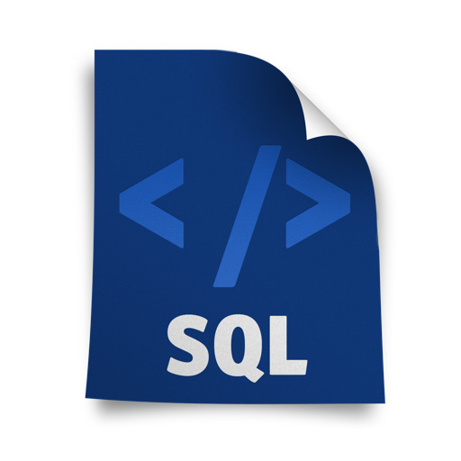
Customer objections
What are the options for running SQL on Hadoop solutions in Azure?
Does Azure offer anything to speed up querying files in HDFS?
Can our users sign in with Azure AD, and can we require two-factor authentication, restrict access based on user, sign in location, time of day, and detected suspicious activity?

Slide 9




Customer objections
Is Azure Data Lake a good fit for our PoC?
What data visualization tools are available on Azure? Can access to these be managed with Active Directory?
Is Azure Databricks our only option for running SQL on Hadoop solutions in Azure?
Notes:
We have heard of Azure Data Lake, but we are not clear about whether this is currently a good fit for our PoC solution, or whether we should be using it for interactive analysis of our data.
We would like to limit access to our SQL DW using centralized Azure Active Directory accounts and groups. Is this possible? I thought I was limited to a user name and password.
Does Azure provide any tools for visualizing our data? Ideally access to these could be managed with Active Directory.

Slide 10
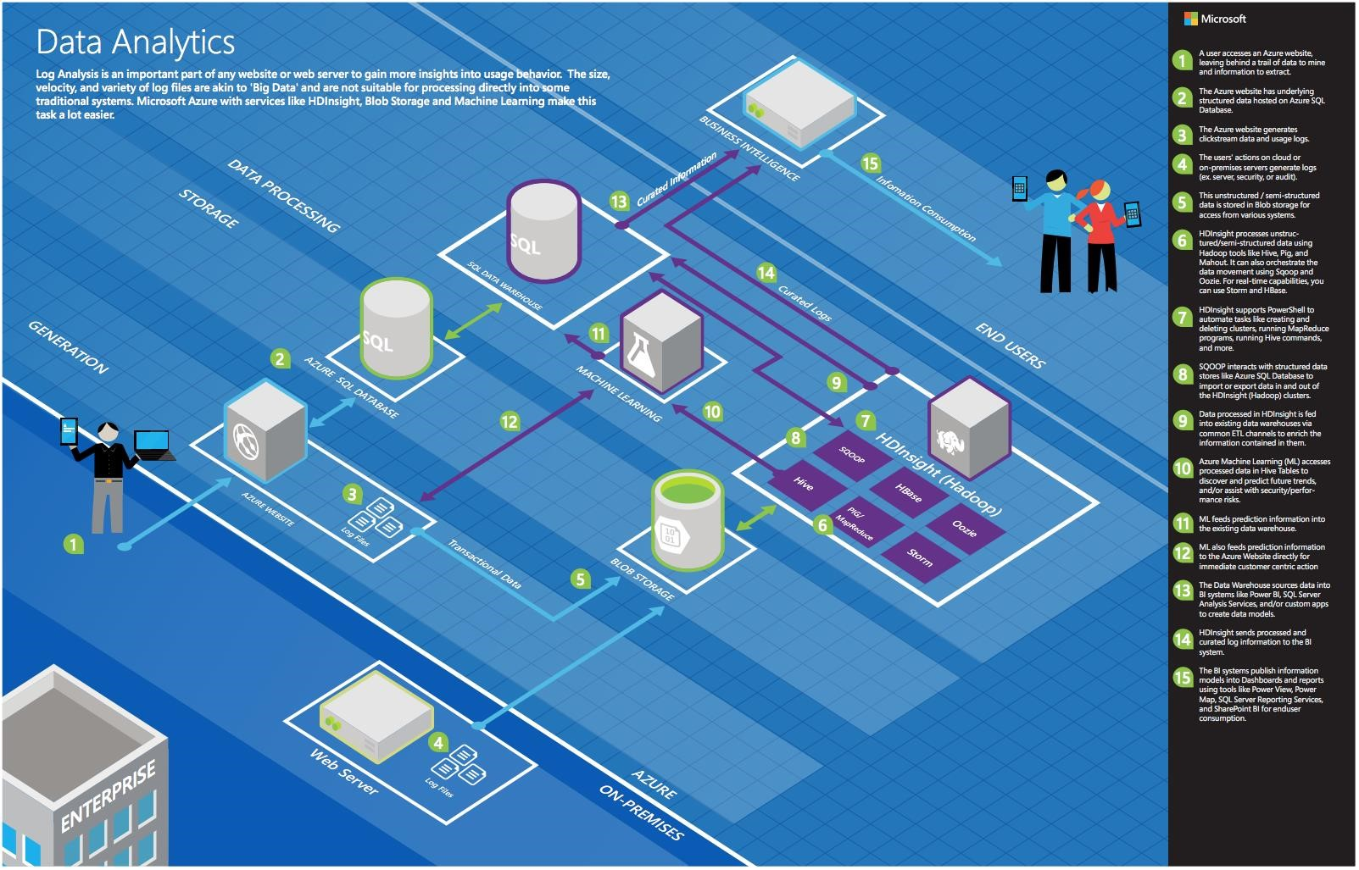
Common scenarios
Notes:
This is a diagram of a common architecture for this type of scenario, which you can draw inspiration from. You will find this diagram within the Whiteboard Design Session Student Guide.

Slide 11
Step 2: Design the solution
Outcome
Design a solution and prepare to present the solution to the target customer audience in a 15-minute chalk-talk format.
Timeframe
60 minutes
Business needs (15 minutes) | Respond to questions outlined in your guide and list the answers on a flipchart.
Design (35 minutes) | Design a solution for as many of the stated requirements as time allows. Show the solution on a flipchart.
Prepare (15 minutes) | Identify any customer needs that are not addressed with the proposed solution. Identify the benefits of your solution. Determine how you will respond to the customer’s objections. Prepare for a 15-minute presentation to the customer.

Slide 12
Step 3: Present the solution
Outcome
Present a solution to the target customer in a 15-minute chalk-talk format
Timeframe
30 minutes (15 minutes for each team to present and receive feedback)
Directions
Pair with another table
One table is the Microsoft team and the other table is the customer
The Microsoft team presents their proposed solution to the customer
The customer asks one of the objections from the list of objections in the case study
The Microsoft team responds to the objection
The customer team gives feedback to the Microsoft team

Slide 13
Wrap-up
Outcome
Identify the preferred solution for the case study
Identify solutions designed by other teams
Timeframe
15 minutes

Slide 14

Preferred target audience
Jack Tradewinds, CIO of Margie's Travel
The primary audience is business decision makers and technology decision makers
Usually we talk to the Infrastructure Managers who report to the CIOs, or to application sponsors (like a VP LOB, CMO) or to those who represent the Business Unit IT or developers that report to application sponsors
Notes:
Jack Tradewinds, CIO of Margie's Travel
The primary audience is business decision makers and technology decision makers.
Usually we talk to the Infrastructure Managers who report to the CIOs, or to application sponsors (like a VP LOB, CMO) or to those that represent the Business Unit IT or developers that report to application sponsors.

Slide 15
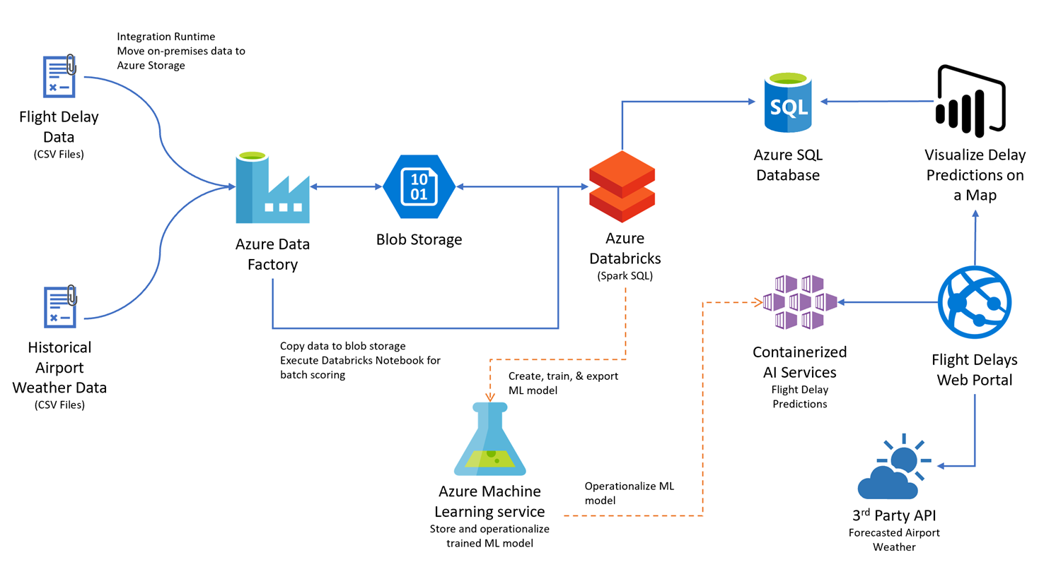
Preferred solution
Notes:
At a high level:
Historical data being copied into Azure blob storage utilizing Azure Data Factory
Historical data explored and prepared using Spark SQL on Azure Databricks
Azure Machine Learning model created and operationalized into a published Predictive Web Service for the web app to query
Batch ML scoring handled via Azure Data Factory. Data written back to blob storage, for querying via Spark SQL. Data also written to Azure SQL Database for access from Power BI
Map visualizations are provided via an embedded Power BI report
Weather forecast data is provided through a third-party API, such as darksky.net.

Slide 16
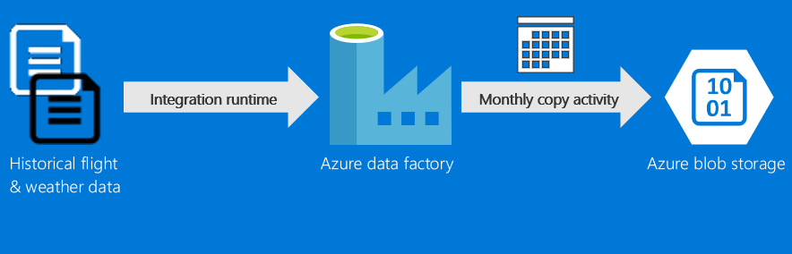
Preferred solution
Data Loading
Notes:
How would you recommend that MT get their historical data into Azure? What services would you suggest, and what are the specific steps they would need to take to prepare and transfer the data? Where would the loaded data land?
Loading historical flight and weather data from their on-premises data store into Azure should be performed using Azure Data Factory (ADF).
Use a continuous pipeline containing a copy activity configured to copy time partitioned source data into Azure
Scheduled job will copy all historical files into Azure storage, as well as ingest any future data
Because their historical data is stored on-premises, MT would need to install and configure an Azure Data Factory Integration Runtime (formerly known as a Data Management Gateway). Once in place, this would allow ADF to copy data from their local data store to a container in blob storage.
Their pipeline would be configured to run monthly, as that is the frequency at which new data is received, and this would still allow for all their historical data to be copied without delay.

Slide 17
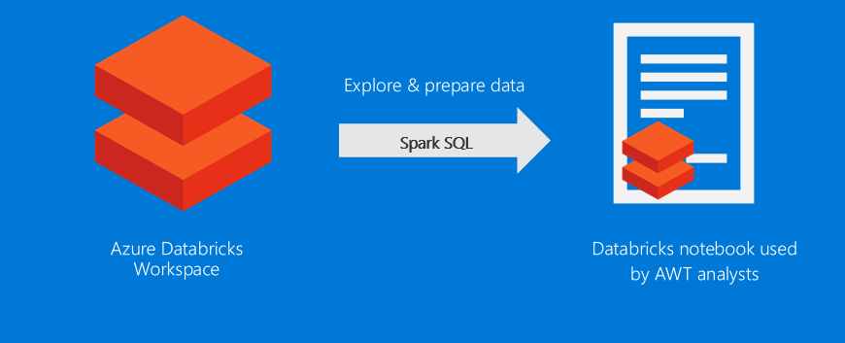
Preferred solution
Data preparation
Notes:
What service would you recommend MT capitalize on in order to explore the flat files they get from the United States Department of Transportation (USDOT) using SQL?
MT could use Azure Databricks to prepare their data using SQL using Spark SQL to query files that live on any number of data sources such as Azure Blob Storage.
What specific configuration would you use? What components of Azure Databricks would you use to allow MT analysts to query and prep the data? How would they author and execute these data prep tasks?
They should use Spark SQL within Databricks notebooks. This gives them a simple, interactive interface that allows them to use programming languages such as Python, Scala, and R to prepare their data and train their data models. When a notebook is created or an existing one is opened, they would need to attach it to a cluster. This provides them with a kernel that gives them a preset sqlContext that can be used to run Hive queries using Spark SQL syntax on the data, which allows the to leverage their existing SQL skills. They would need to create the appropriate external tables atop the flight delay files available in HDFS, which reads from the Azure Storage account attached to their Azure Databricks instance.

Slide 18
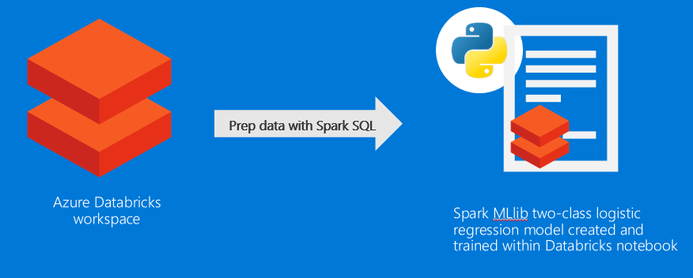
Preferred solution
Machine learning model
Notes:
What technology would you recommend that MT use for implementing their machine learning model?
The model will first be built and trained within an Azure Databricks notebook. The data scientists can use the programming language of their choice (Python, Scala, R, etc.) as well as Spark SQL to featurize and fit the data into the chosen machine learning algorithm. Machine learning libraries such as Spark MLlib or SciKit-Learn can be used within the notebook to simplify things. Once the model is trained and tested with a sufficient amount of historical data, then the model can be exported for deployment to a web service. The model can also continued to be used within Azure Databricks for batch scoring.
How would you guide MT to load data so it can be processed by the machine learning model?
The data used for training could either be uploaded directly to Azure Databricks, creating a new table with the data stored in DBFS (Databricks File System). Then the data can be accessed from this global persistent table using Spark SQL syntax or DataFrames. Alternately, if they need to train the model with a very large amount of data, the data can be stored in Azure Storage, then the Storage account can be mounted to an Azure Databricks cluster. From that point, the data can be accessed using the wasb/wasbs path and loaded into a DataFrame. Alternately, the data can be persistedd into a global table so that it can be easily accessed using Spark SQL syntax and across cluster sessions.
What category of machine learning algorithm would you recommend to MT for use in constructing their model? For this scenario your options are clustering, regression or two-class classification. Why?
Given that MT only wants a binary prediction of flight delayed or flight not delayed, they should proceed with a two-class classification algorithm, such as logistic regression.

Slide 19


Preferred solution
Machine learning model
Start with domain knowledge
Remove fields that do not add value
Validate preliminary model against training data
Notes:
What attributes of the flight and weather data do you think MT should use in predicting flight delays? How would you recommend that MT identify the columns that provide the most predictive value in determining if a flight will be delayed? Be specific on the particular modules or libraries they could use and how they would apply them against the data.
There are multiple approaches MT could use to perform feature selection and to identify the data attributes that are the most helpful in accurately predicting a delay.
Start with any domain knowledge they have—this would likely point in the direction of the flight attribute’s airline, departure airport, destination airport, and time of day as well as the weather attribute’s wind speed, temperature, and precipitation conditions.
Additionally, they should identify and remove fields that do not add value (for example, because they are mostly empty or only have a constant value).
Construct a preliminary model and validate how it performs against the training data.
In additional passes, they might choose to use one or more binary evaluation metrics to score the effectiveness of the model.

Slide 20


Preferred solution
Python programming logo
Machine learning model
Data munging with R or Python
Reserve some historical data to “test” the model
Measure error on the training set and validation sets separately for indicator of whether model is in danger overfitting
Notes:
Some of the data may need a little touching up: columns need to be removed, data types need to be changed. How would these steps be applied in your model?
Data munging can be best accomplished using R or Python, languages familiar to data scientists and developers. These languages provide powerful data transformation capabilities, and allow for flexibility in how data cleanup occurs, while reducing the overall complexity of ML models. These steps should be performed before featurization. You can use a Spark Pipeline to organize your data transformation steps in order.
How would you recommend MT measure the success of their model?
For a classification model, they should measure the success of their model against a data set whereby a large portion of the data is used for training purposes, but a smaller set is reserved as examples that will be used to "test" the model to see how it performs against a known outcome. The output of the prediction as well as the "correct" output is passed to the one or more binary evaluation metrics which provide scores such as those from the Confusion Matrix, part of the MLlib MulticlassMetrics library, that give a perspective on accuracy and in what situations the models make mistakes.

Slide 21
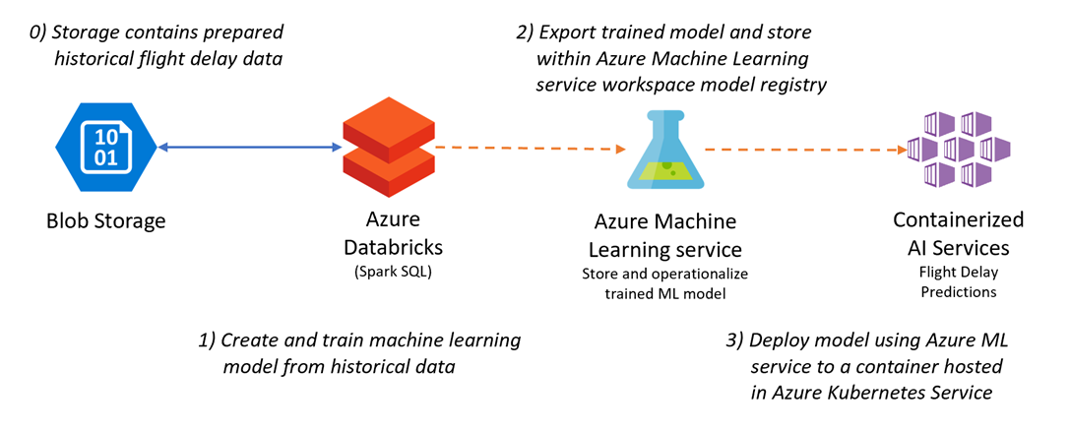
Preferred solution
Operationalizing machine learning
Notes:
How can MT release their model for production use and avoid their concerns about extremely long delays operationalizing the model? Be specific on how your model is packaged, hosted, and invoked.
MT can use Azure Machine Learning service and the Azure Machine Learning SDK to register the model in Azure ML's model registry and automatically deploy the model to an Azure Kubernetes Service (AKS) cluster. This creates a web service that can be invoked by any REST client, and the cluster can scale to meet demand as needed. This deployed web service takes the weather conditions and flight information as input and returns a response with the classification.

Slide 22
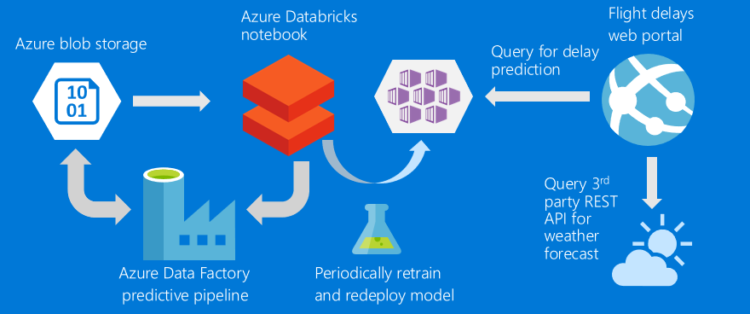
Preferred solution
Operationalizing machine learning
Notes:
MT has shown interest in not only scoring a flight at a time (based on a customer’s request), but also doing scoring in large chunks so that they could show summaries of predicted flight delays across the United States. What changes would you need to make to your ML model to support this?
The model should be created in such a way that data is prepared and featurized in a consistent way each time it is executed. This way, it can be used equally well for both interactive and batch scoring. The model should be provided within an Azure Databricks notebook that accepts input parameters that point to the file location of the data that needs to be batch processed. This can be implemented via Azure Data Factory (v2) by adding a Linked Service to Azure Databricks and configuring the path and parameters to send to the notebook. By using ADF, they can apply the operational model to data as it is moved to the proper location in Azure storage. The scored results will be available in Blob storage after processing, and with the scheduled pipeline new data will be processed automatically, on the schedule indicated by the pipeline.
The notebook that is executed also writes the summarized flight delay predictions to an Azure SQL Database. This data will be used by Power BI to display the predictions in a series of reports and dashboards.
How would you suggest MT integrate weather forecast data?
They could retrieve the weather forecast data from a third-party service that provides a REST API. An example of such a service is DarkSky (darksky.net).

Slide 23
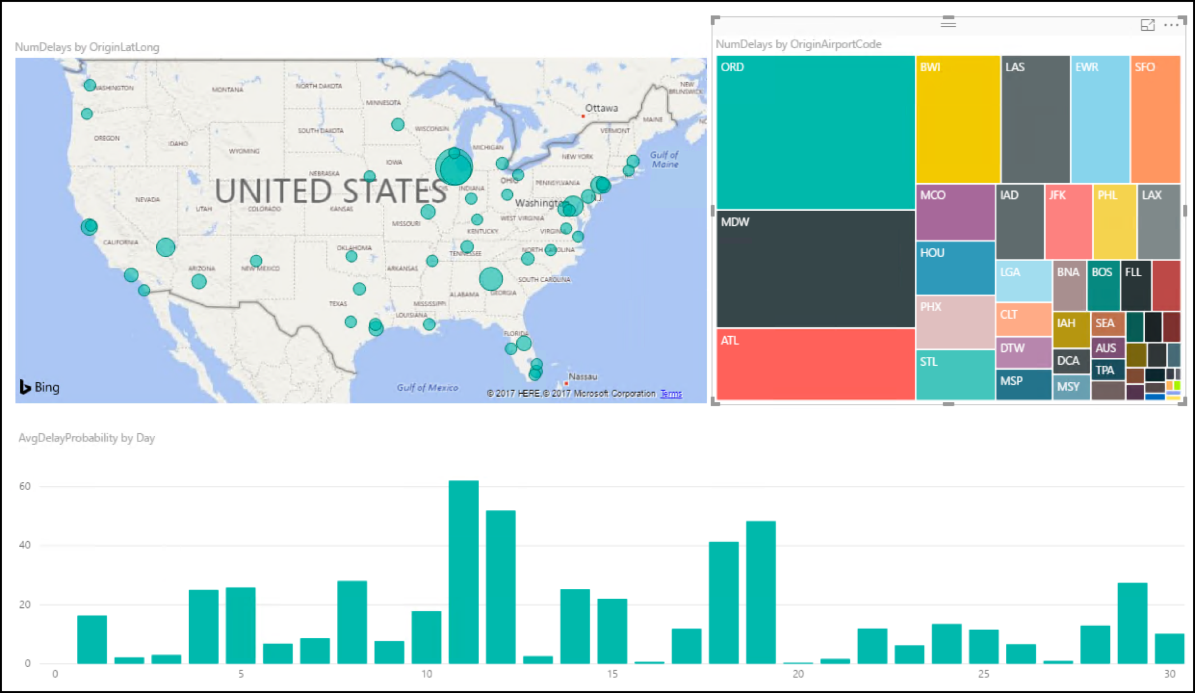
Preferred solution
Visualization and reporting
Power BI is a good option
Direct Query against Azure SQL Database
Use map visualization
Notes:
Is Power BI an option for MT to use in visualizing the flight delays?
Yes, Power BI is a good option for MT. Power BI can perform what is called a Direct Query against Apache Spark hive data sources as well as an Import query that copies the data into Power BI managed datasets from Spark. However, connecting Power BI to a Azure Databricks cluster requires it to be running any time a report is displayed. A more cost-effective solution is to write the summarized data to an Azure SQL Database each time the notebook is executed during the batch scoring process. In this case, Power BI uses Direct Query against the Azure SQL Database instead, allowing MT to terminate clusters that are not in use.
How would MT load the data and plot it on a map? What specific components would you use and how would you configure them to display the data?
The preferred solution for visualizing bulk delay predictions is to load a Power BI embedded report containing map visualizations for delays by airport into the Flight Delays web app. The report uses Power BI Direct Query against an Azure SQL Database table written to by the automated batch scoring process run in an Azure Databricks notebook.

Slide 24

Preferred solution
Visualization and reporting
Use Query Editor component of the Power BI Desktop, then upload to Power BI service
Create content pack with Power BI
Restrict access in Azure AD
Notes:
If they need to make minor changes, such as a change to the data types of a column in the model, how would they perform this in Power BI?
Minor changes, such as a change to the data types of a column in the model, can be accomplished using the Query Editor component of the Power BI Desktop application. They could then upload this file to the Power BI service.
How could they secure access to these reports to only their internal customer service agents?
Access to these reports can be secured to only their internal customer service agents by utilizing the Power BI service. They can create a Content Pack that contains only the desired dashboards, reports, and datasets and restrict access to those groups in Azure Active Directory to which the customer service agents belong.

Slide 25
Customer objections
How long does it take to create and operationalize a machine learning model?
Can we retrain and redeploy our models without breaking clients?
Notes:
We have heard that creating a machine learning model takes a month to build and another 2–3 months to operationalize so that it is useable from our production systems. Is this true?
This is true in the traditional process for creating machine learning models, whereby the data scientist creates a model (e.g., in R) and then hands it over to developers who translate it into Java or C#---which can take months to get the translation correct and performant. With Azure Machine Learning service, you can deploy Docker-based container images with a single command to Azure Kubernetes Service managed by the Azure ML workspace. During the process, a REST API for the deployed model is generated along with a swagger document. This makes it very easy for clients to consume the model.
Once our model is operationalized, how do we retrain and redeploy it? Will this process break clients currently accessing the deployed model?
Azure Machine Learning service provides APIs that you can use to retrain your models. You can also use the APIs to update existing deployments with updated versions of the model. As part of the data science workflow, you recreate the model in your experimentation environment. Then, you register the model with Azure Machine Learning service model registry and update existing deployments. Updates are performed using a single UPDATE CLI command. The UPDATE command updates existing deployments without changing the API URL or the key. The applications consuming the model continue to work without any code change, and start getting better predictions using new model.

Slide 26
Customer objections
What are the options for running SQL on Hadoop solutions in Azure?
Does Azure offer anything to speed up querying files in HDFS?
Can our users sign in with Azure AD, and can we require two-factor authentication, restrict access based on user, sign in location, time of day, and detected suspicious activity?
Notes:
Can we query flat files in the file system using SQL?
Yes. There are many options for using a SQL syntax to query files in Blob storage such as Azure Databricks, SQL Data Warehouse, and HDInsight with Spark SQL or Hive.
Is Azure Databricks our only option for running SQL on Hadoop solutions in Azure?
No. Azure HDInsight provides an option for running hosted Spark clusters as well. Within HDInsight, you can provision hosted clusters based on Hive, HBase, and others. Hortonworks, Cloudera, and MapR provide fully supported distributions that are available in the Azure Marketplace and provide environments for running HiveQL Spark SQL in Azure.
Does Azure provide anything that would speed up querying (and exploration) of files in HDFS?
Yes. SQL Data Warehouse provides the ability to create indices on flat file content, as does Hive on HDInsight.
Spark SQL on Azure Databricks provides a distributed in-memory cache that can aid exploratory queries that often repeat queries against the same subsets of data.
Can we use Azure Active Directory accounts for our users, and if so, can we restrict who can access Azure Databricks, when they can access it, require two-factor authentication, and restrict access if there is suspicious activity on their account?
Azure Databricks is automatically integrated with Azure Active Directory (Azure AD). This allows you to control access to your workspace and allows users to sign in with their Microsoft or organizational account. Since users can sign in from a variety of devices from anywhere, simply focusing on who can access a resource is not sufficient anymore. Azure AD conditional access helps address this requirement by implementing automated access control decisions based on conditions. With conditional access, you can restrict sign-ins to your corporate network, require multi-factor authentication, restrict hours in which users can log in, and restrict access if there is a detected sign-in risk.

Slide 27
Customer objections
Is Azure Data Lake a good fit for our PoC?
What data visualization tools are available on Azure? Can access to these be managed with Active Directory?
Is Azure Databricks our only option for running SQL on Hadoop solutions in Azure?
Notes:
We’ve heard of Azure Data Lake, but we’re not clear if this currently a good fit for our PoC solution, or if we should be using it for interactive analysis of our data.
Azure Data Lake Analytics provides a distributed querying engine whose costs are based solely on the number of resources used in the query, the amount of time those resources were made available to the query and a nominal job completion charge.
Azure Data Lake Analytics currently supports only Batch workloads, so it is not the right tool for interactive analytic workloads.
Azure Data Lake Storage Gen2 provides the ability to store an unlimited number of items, each of unlimited size, having no upper limit on the total storage capacity. This makes it more capable than Azure Blob Storage since it removes the 2 PB account size limit, the page blob size limit, and the block blob limit imposed by Blob storage. However, given MT's low data growth projection, this is not a concern for them.
Another differentiator between the two storage services is that Blob Storage uses a flat storage schema with path names as part of the bob file names. This makes the WASB driver Spark uses to connect to Blob Storage for HDFS access do extra work to map file structures to blob paths. This can lead to degraded performance in cases of high volume and many small files. In contrast, ADLS Gen2 has hierarchical storage that provides granular POSIX permissions and Access Control Lists (ACLs). This provides greater flexibility in controlling access to files, and Spark uses the newer ABFS driver which can provide higher performance. However, MT's requirements do not include fine-grained permissions and hierarchical storage, and the size and velocity of their data will mean that they would likely never notice a significant performance difference between the two options.
Given their requirements and comparison of services, Blob Storage is recommended as it meets MT's requirements, and is a more cost-effective solution.
Does Azure provide any tools for visualizing our data? Ideally access to these could be managed with Active Directory.
Power BI is available as a service and provides tools for creating both dashboards and reports whose access can be restricted by group membership in Azure Active Directory.
Is Azure Databricks our only option for running SQL on Hadoop solutions in Azure?
No. Azure HDInsight provides an option for running hosted Spark clusters as well. Within HDInsight, you can provision hosted clusters based on Hive, HBase, and others. Hortonworks, Cloudera, and MapR provide fully supported distributions that are available in the Azure Marketplace and provide environments for running HiveQL Spark SQL in Azure.

Slide 28
Customer quote
“We are flying into the future with Azure, helping our customers more aggressively schedule their travel, and optimize their non-travel time.”
- Jack Tradewinds, CIO of Margie's Travel

